Slide 1

Ultimate Space Rumble Smash Fighter Z 2: Maximum Bullet Storm
Team Rocket:
Jim Wallace, Jose Santiago, Tony York, James Love, Rhett Wallace, & Jacoby Clark

Slide 2
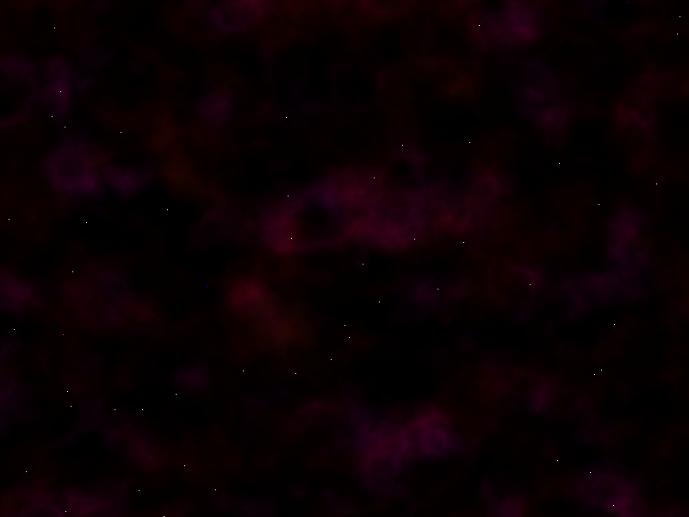
Game Overview
You’re lost in space! As you travel through an alien galaxy, you are forced to go through an asteroid belt. Unfortunately, your blasters went out a while ago, so you must solely rely on your gas and your quick reflexes to get through the belt. Using the ASWD buttons, you can travel up, down, left and right to dodge different types of asteroids. The longer you go, the harder it gets! Once you lose all health, KABOOM!

Slide 3
Game Requirements
Requirements: a PC, a Java IDE, access to the A,S,W,D pad.

Slide 4
Game Specifics
Level 1: small orange bullets fall from the ceiling.
Level 2: after 1 minute, blue bullets fall with orange. These are faster and slightly larger than the orange.
Level 3: after 2 minutes, large green bullets, in addition to the blue and orange. These are slower than the blue, but are significantly larger.
Level 4: after 5 minutes, large “boss” falls with bullets. Largest bullet of the game, about the same speed as Level 3.
Health falls from ceiling, and can be collected to regain health.
Notes:
Open to edits

Slide 5
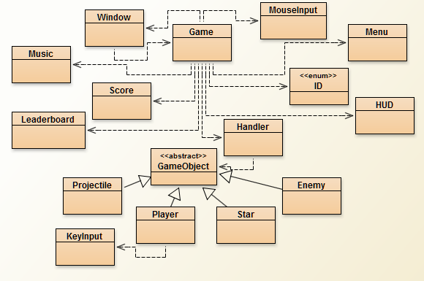
Class Diagram

Slide 6
Developmental Notes
Originally meant to be a fighting game
Enemy and Items that weren’t originally planned were added as the project progressed
Added Game States to replace classes
Consolidated enemies into a single class
After demo presentations many suggestions from classmates were implemented
Shields
Coins
Movements
Leaderboards
Music
Balancing

Slide 7
Timeline
Week 1: Fighting game sprite design and background images
Week 2: Sprite Animation and background display
Week 3: Framework for the game written
Week 4: Design elements reconsidered (went back to the drawing board)
Week 5: Created a GUI and new sprites
Week 6: Changed the game to a “bullet hell” and prepared the demo
Week 7: Implemented suggestions from demo presentation
Week 8: Final Presentation

Slide 8









Sprites

Slide 9
**TIME FOR THE DEMO**

